Slide 1
DataBank
Nathon Iadimarco

Slide 2




Coded using SQL, PHP, HTML, and CSS.

Slide 3
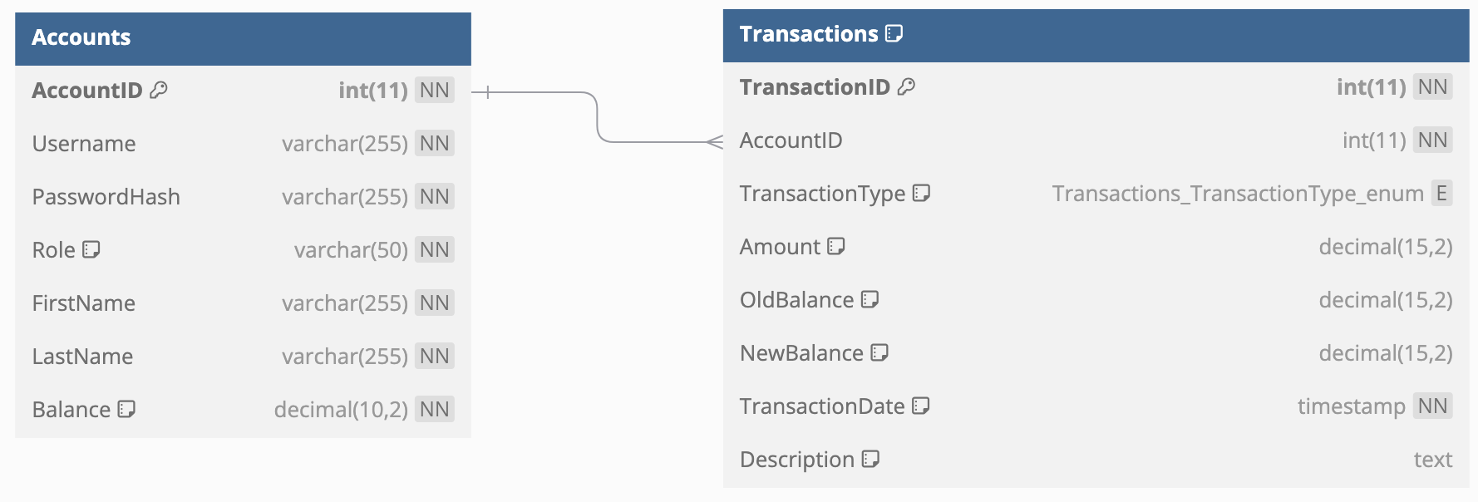
Database Schema

Slide 4
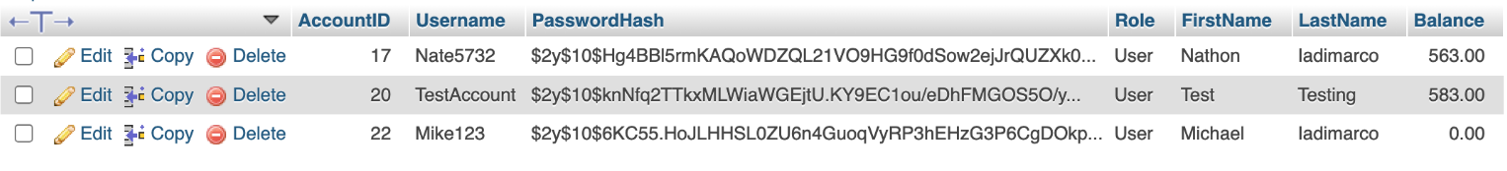
SQL ‘Accounts’ Table

Slide 5
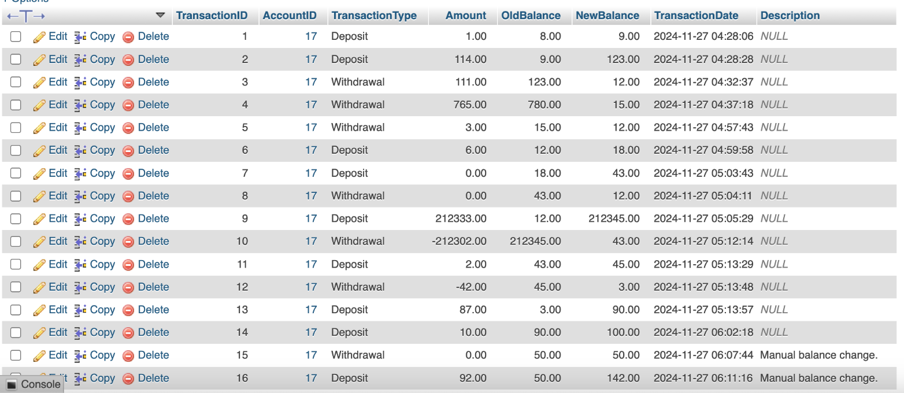
SQL ‘Transactions’ Table

Slide 6
Demo
http://localhost:2896/DataBank.php

Slide 7
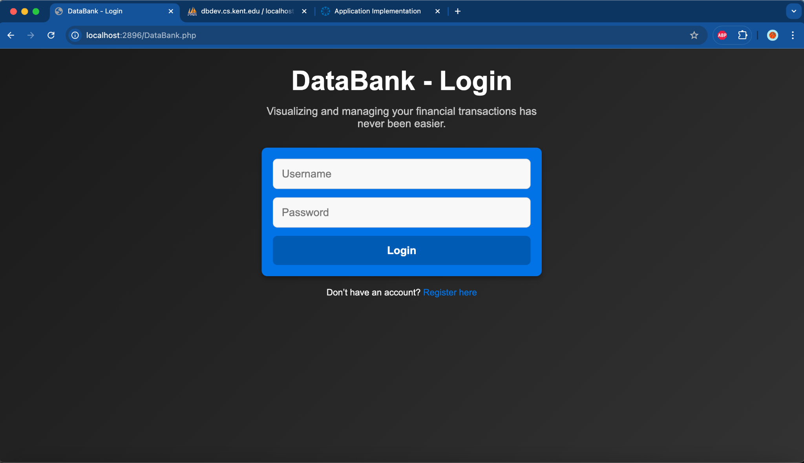

Slide 8
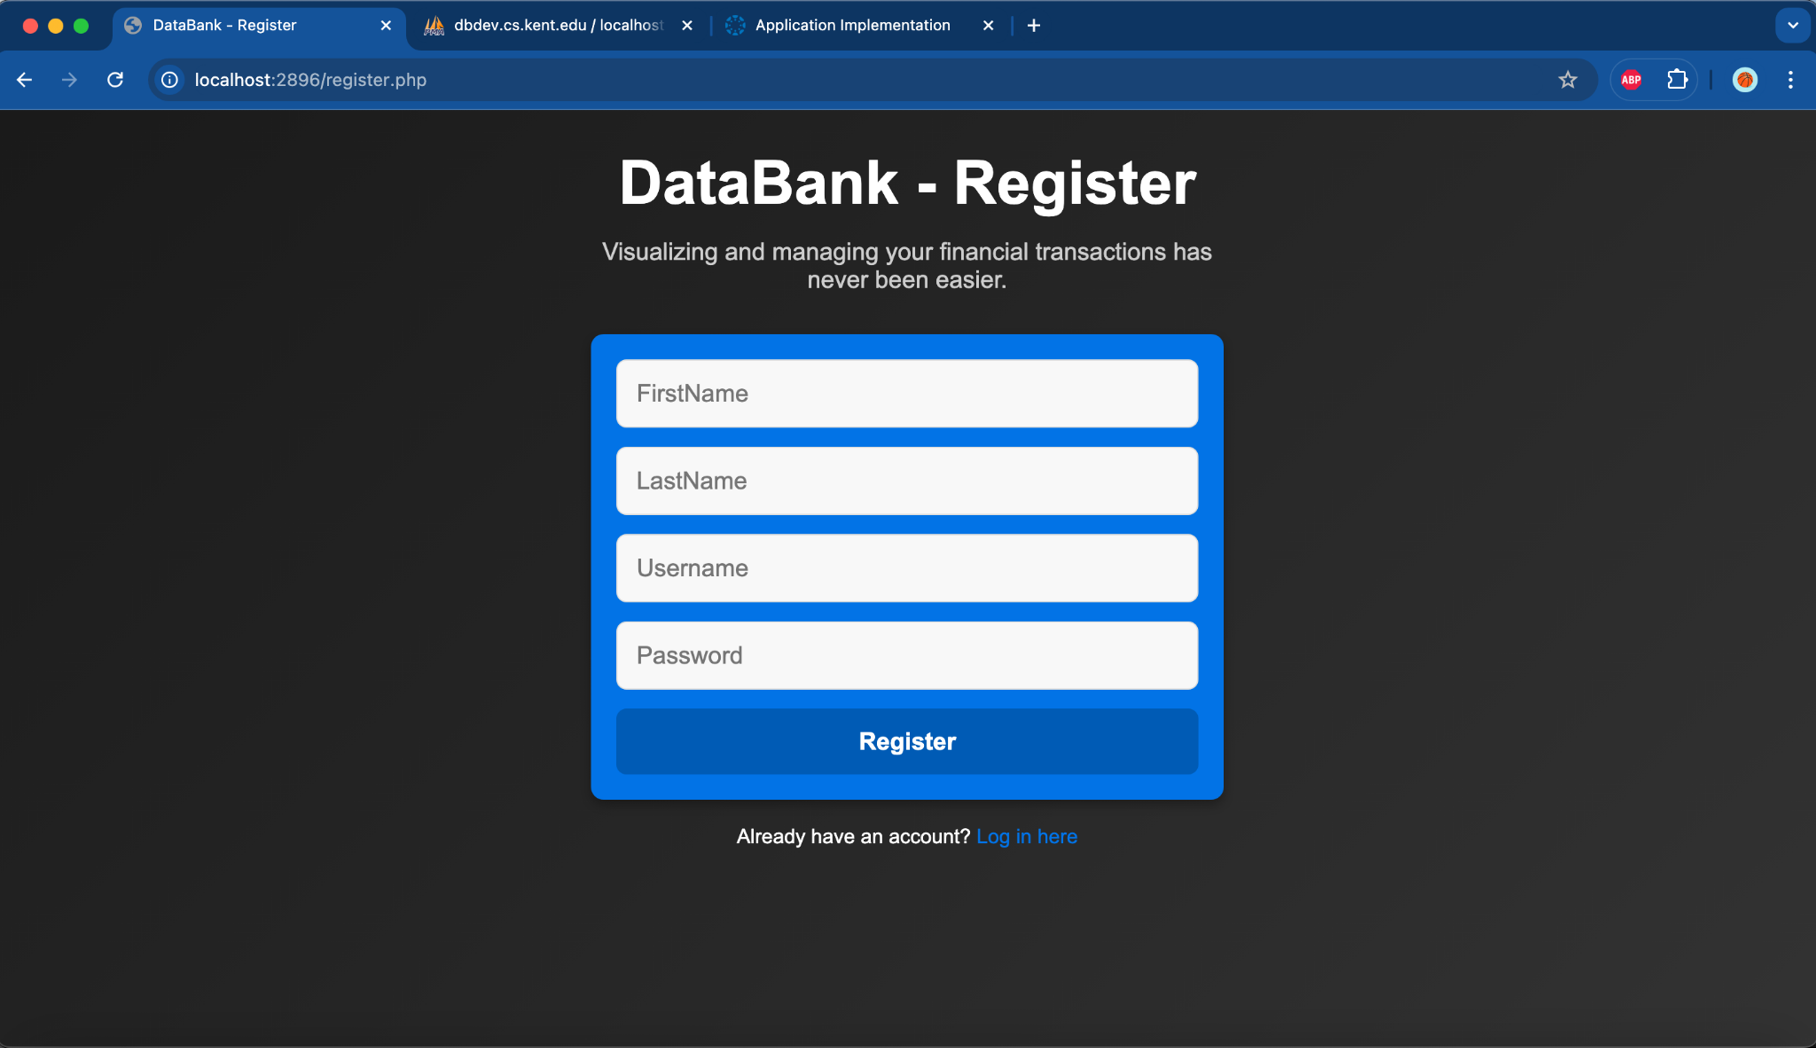

Slide 9
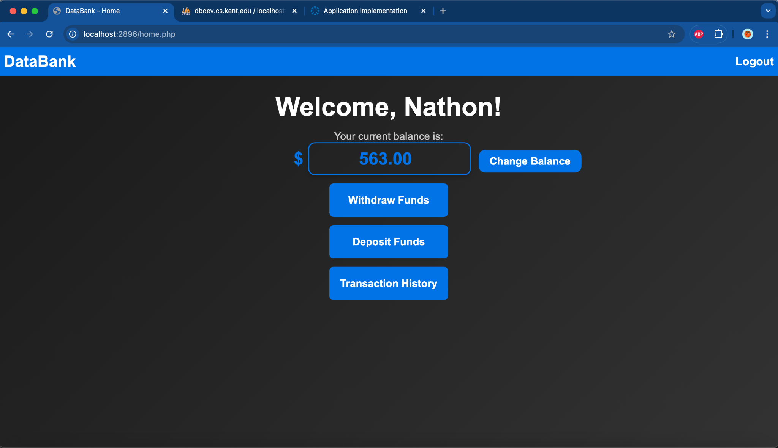

Slide 10
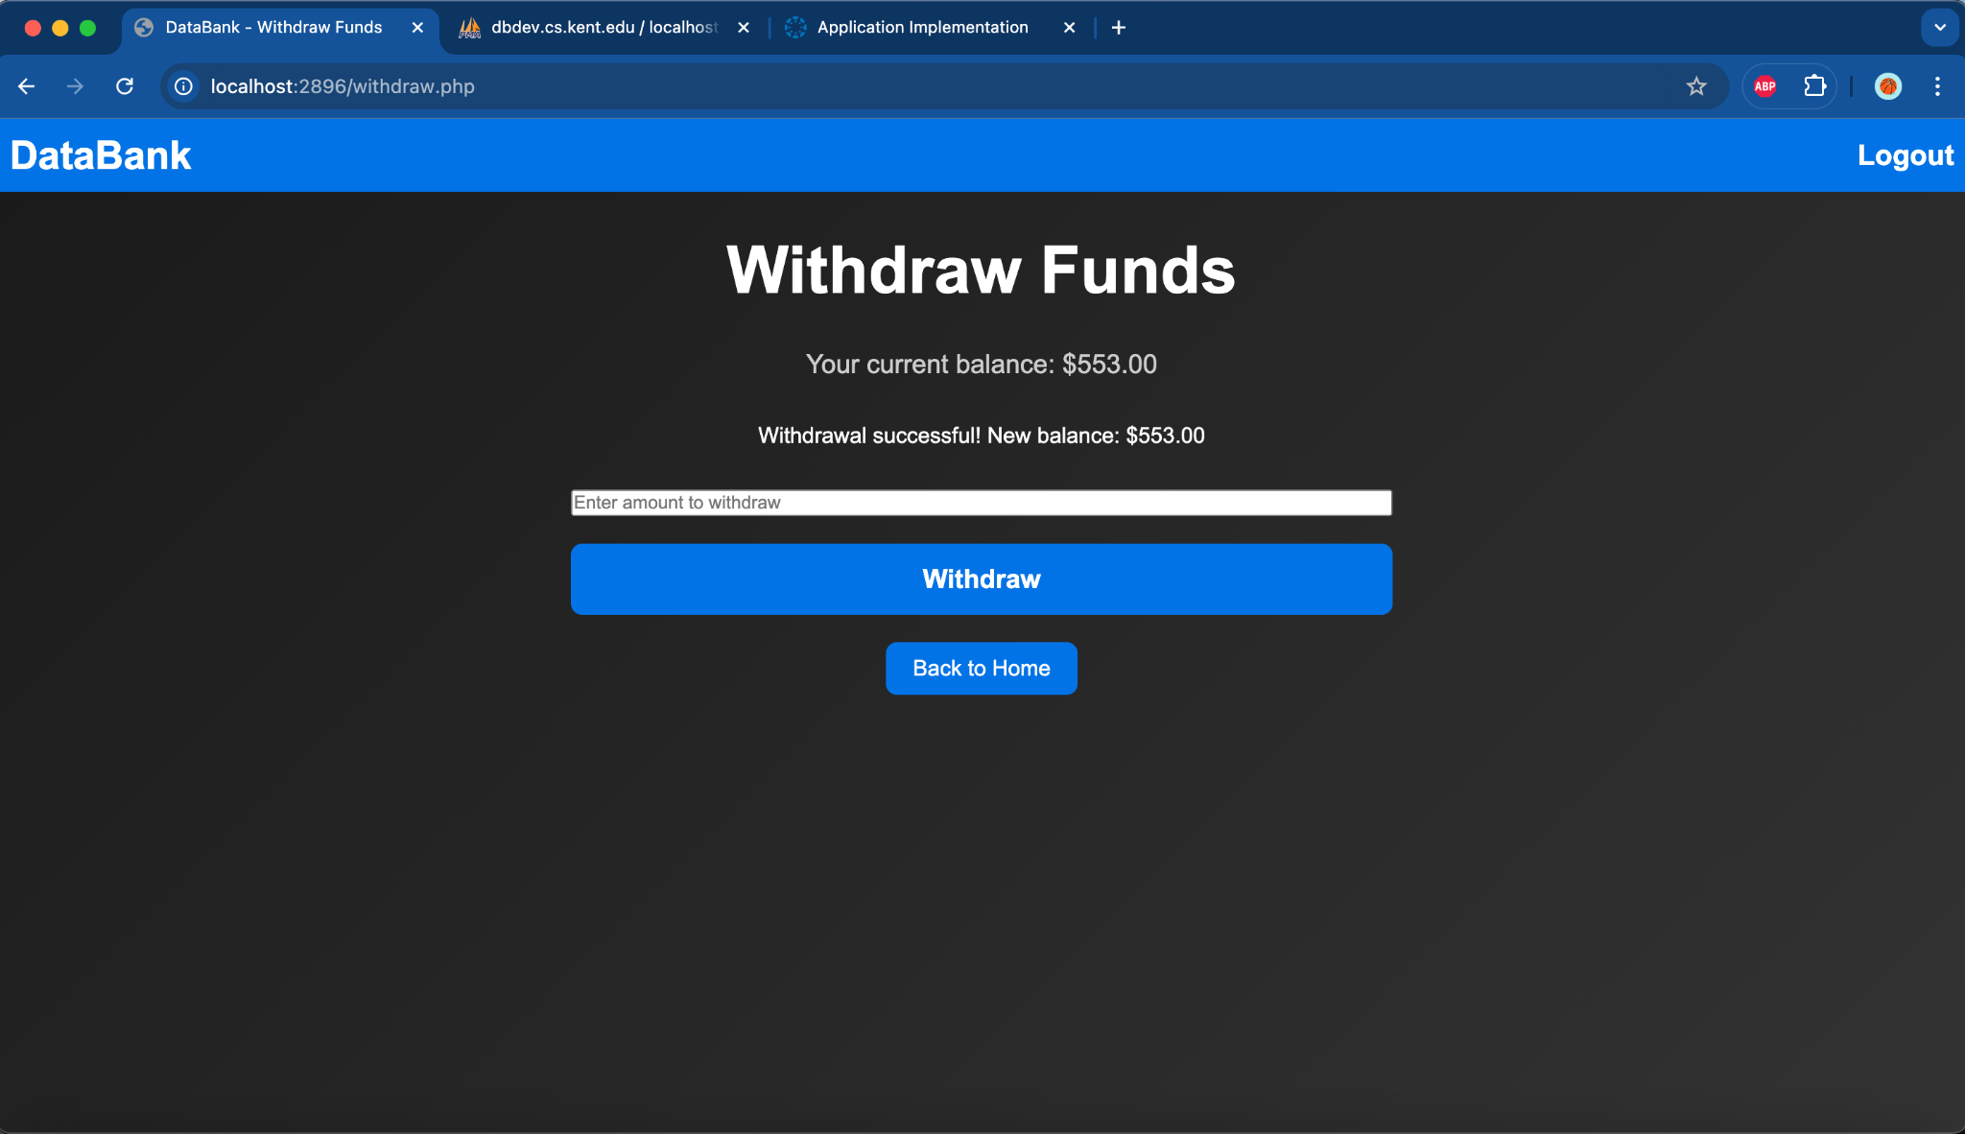

Slide 11
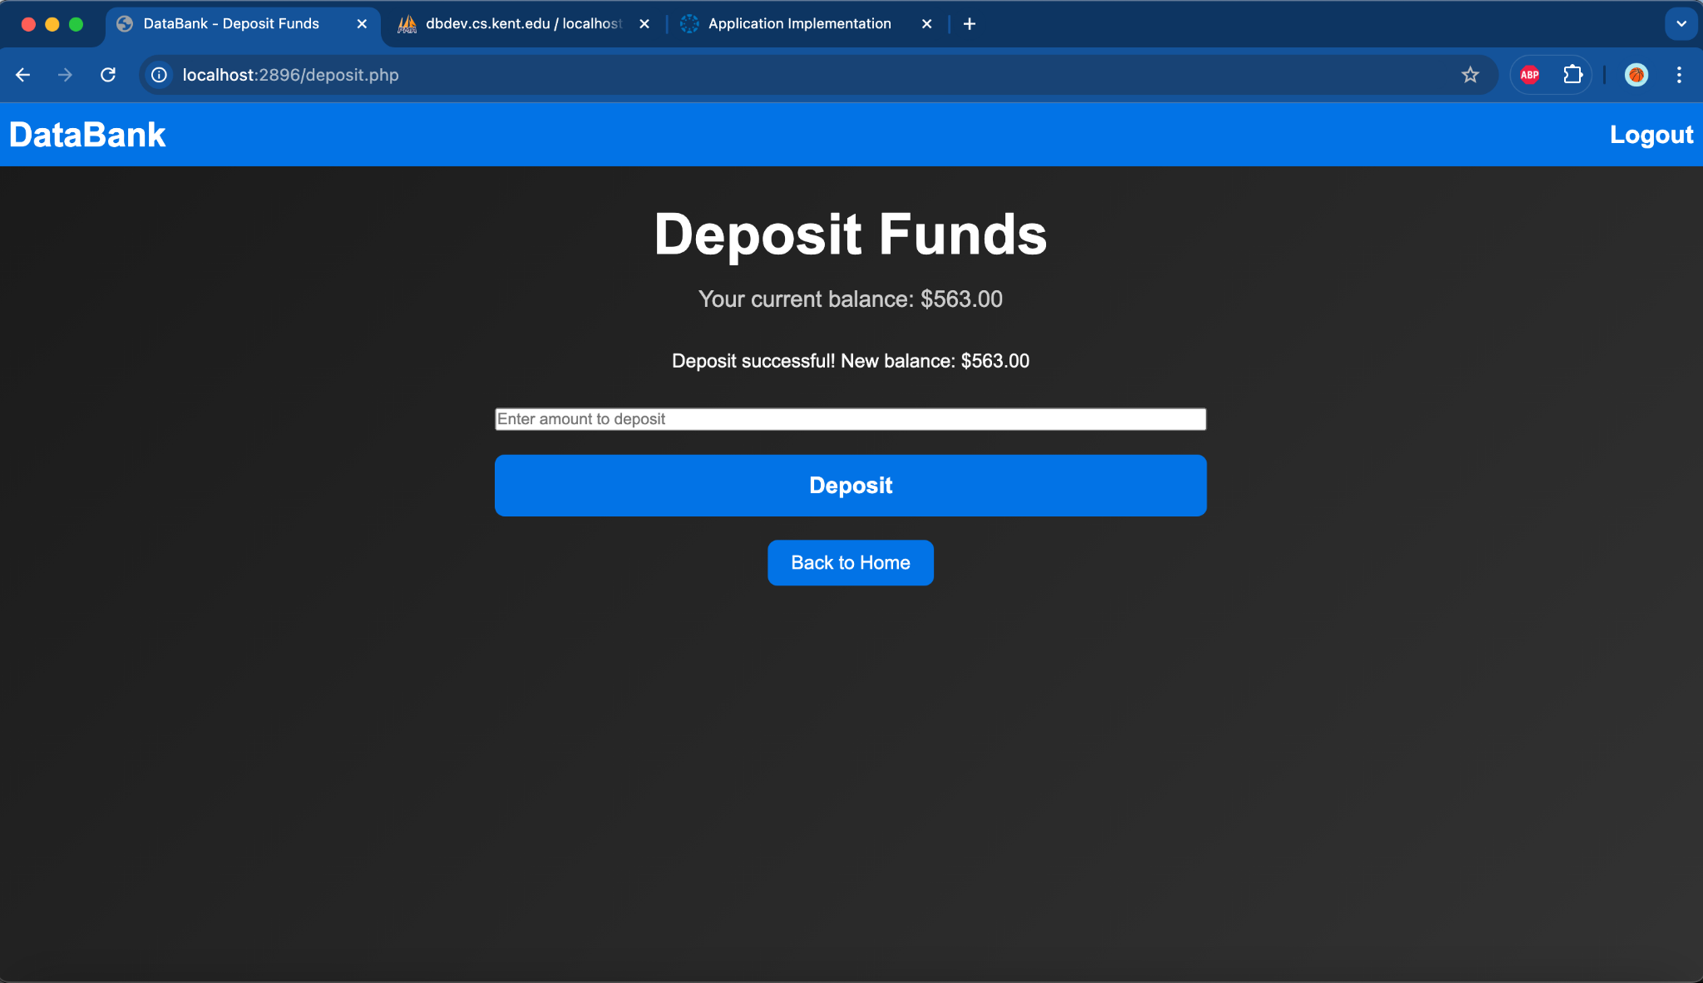

Slide 12
